Slide 1
Session 01
Introduction to Computer Network
Subject : Z1451 / Jaringan Komputer Year : 2015

Slide 2





Rules
assignments
On time!
Read
active
ask
Bina Nusantara

Slide 3

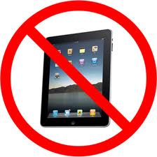

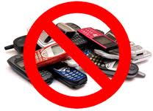


Rules
In lecturing session
Bina Nusantara

Slide 4
Evaluation and Grading
Evaluation and Grading
Total Score 100%
50 % Final Exam
20% Assignment
30% Mid Exam
Bina Nusantara
Bina Nusantara

Slide 5
COURSE
This course presents :
Basic components of network
TCP/IP network architecture
Build a corporate network
Objectives :
Describe basic structures of network
Explain basic concepts of network
Explain concepts of create network in corporate environment

Slide 6
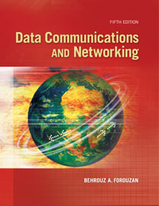
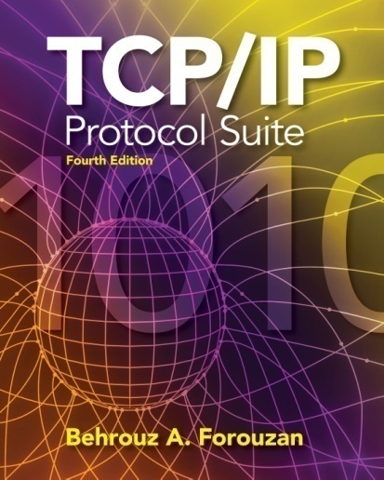
Books
Behrouz A. Forouzan,Sophia Chung Fegan,. 2007. Data communications and networking. McGraw Hill. New York. ISBN:007-125442-0
Behrouz A. Forouzan.. 2007. TCP/IP Protocol Suite. 1st Books Library. New York. ISBN:978-007-108420.

Slide 7
Outline
Communication Model
Switching Techniques
Computer Network Components

Slide 8
Data Communications
Communication Model
Data communication is a combination of two techniques:
- Telecommunications
- Data Processing
Telecommunications :
Process of transmitting information that is converted to a agreed code using electrical medium or electro-optic.
Notes:
4

Slide 9
Communication Model
Component of Communication Model
Sender
generates data signal that must be transmitted.
converts data signal into signal that can be transmitted.
Medium
carries data signal.
Data
Data to be Sent
Receiver
converts received signal to data
Protocol
Rules

Slide 10
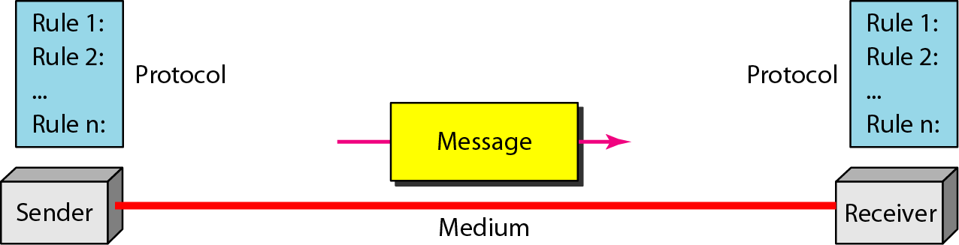
Data Communication Model
Communication Model
Behrouz A. Forouzan,Sophia Chung Fegan,. 2007. Data communications and networking. McGraw Hill. New York. ISBN:007-125442-0

Slide 11
Switching Techniques
Circuit Switching
Communication path between sender and receiver not changed during the exchange of information.
Packet Switching
Using Store & Forward principles.
Data could be sent out of sequence.
Data divided to small packets for transmission.
Packets sent via several nodes before arriving to its destination

Slide 12
Packet Switching
Packet n
Packet 2
Packet 1
n
1
2
n
1
2
n
1
PAD
2

Slide 13
Networking
Point to Point communications is often not economic and practical.
Type of data communication network:
Local Area Network (LAN)
Metropolitan Area Network (MAN)
Wide Area Network (WAN)

Slide 14
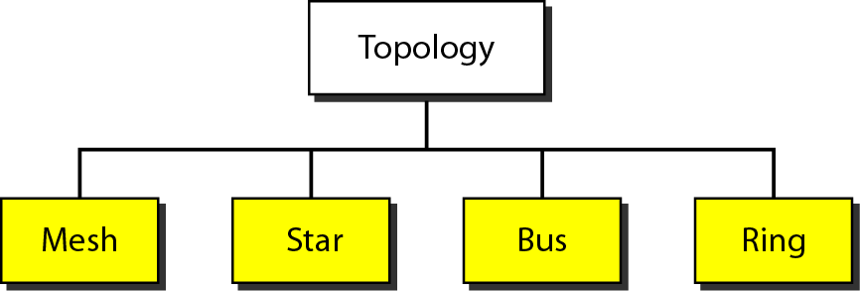
Computer Network Components
Figure 1.4 Categories of topology
Behrouz A. Forouzan,Sophia Chung Fegan,. 2007. Data communications and networking. McGraw Hill. New York. ISBN:007-125442-0

Slide 15
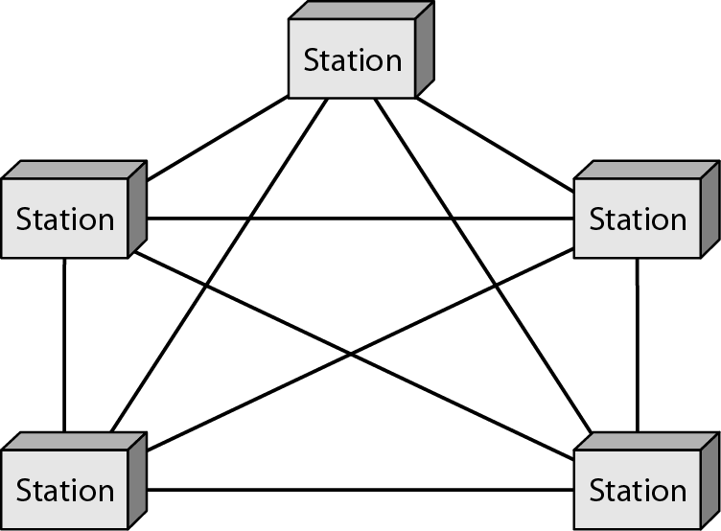
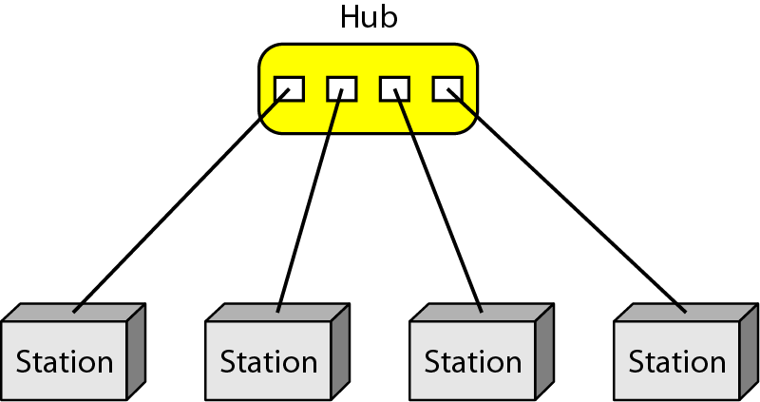
Computer Network Components
Figure 1.5 A fully connected mesh topology (five devices)
Figure 1.6 A star topology connecting four stations
Behrouz A. Forouzan,Sophia Chung Fegan,. 2007. Data communications and networking. McGraw Hill. New York. ISBN:007-125442-0

Slide 16
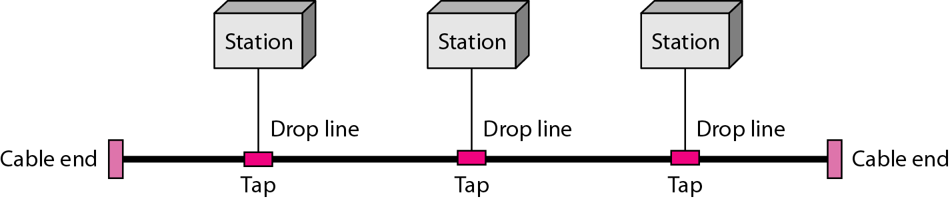
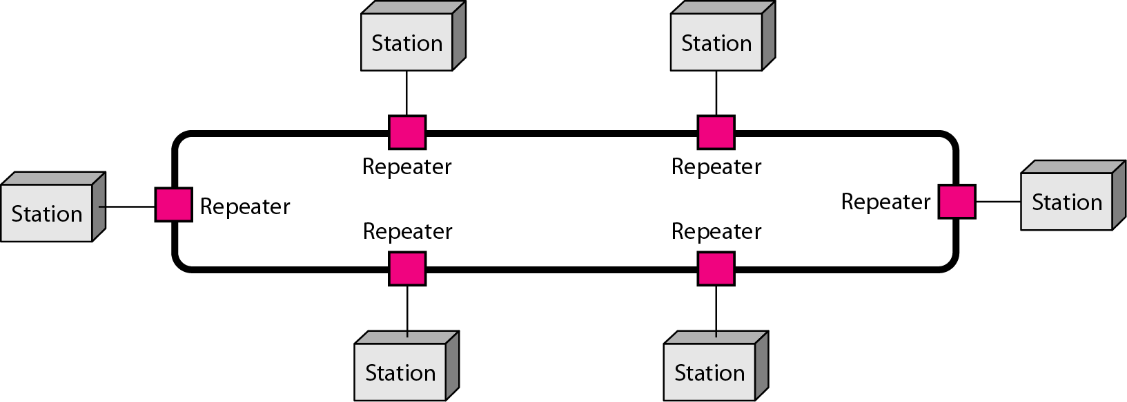
Computer Network Components
Figure 1.7 A bus topology connecting three stations
Figure 1.8 A ring topology connecting six stations
Behrouz A. Forouzan,Sophia Chung Fegan,. 2007. Data communications and networking. McGraw Hill. New York. ISBN:007-125442-0

Slide 17
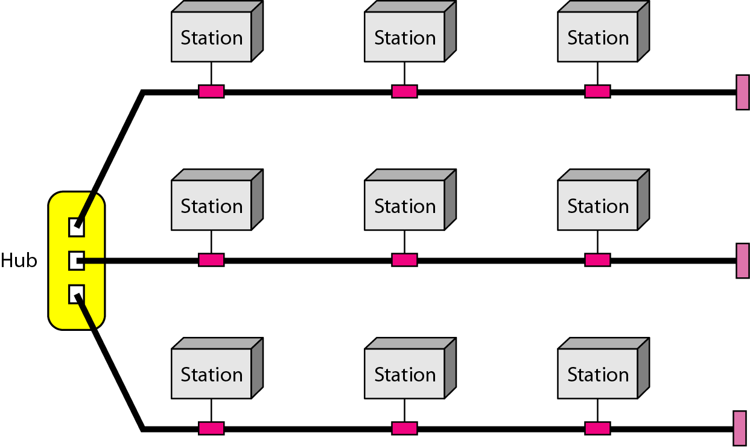
Computer Network Components
Figure 1.9 A hybrid topology: a star backbone with three bus networks
Behrouz A. Forouzan,Sophia Chung Fegan,. 2007. Data communications and networking. McGraw Hill. New York. ISBN:007-125442-0

Slide 18
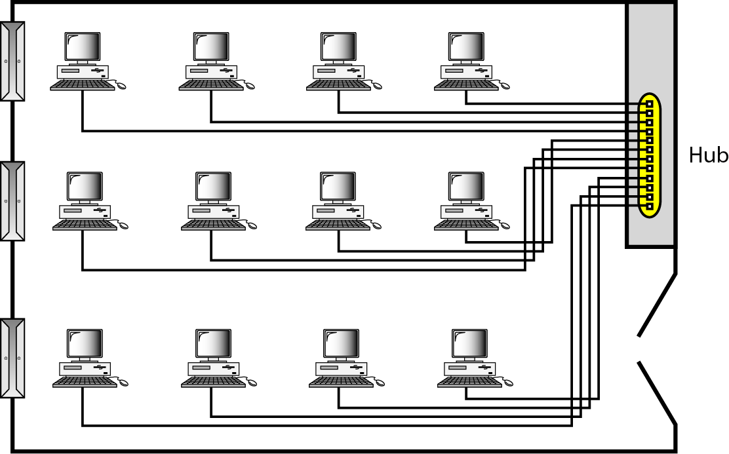
Computer Network Components
Figure 1.10 An isolated LAN connecting 12 computers to a hub in a closet
Behrouz A. Forouzan,Sophia Chung Fegan,. 2007. Data communications and networking. McGraw Hill. New York. ISBN:007-125442-0

Slide 19
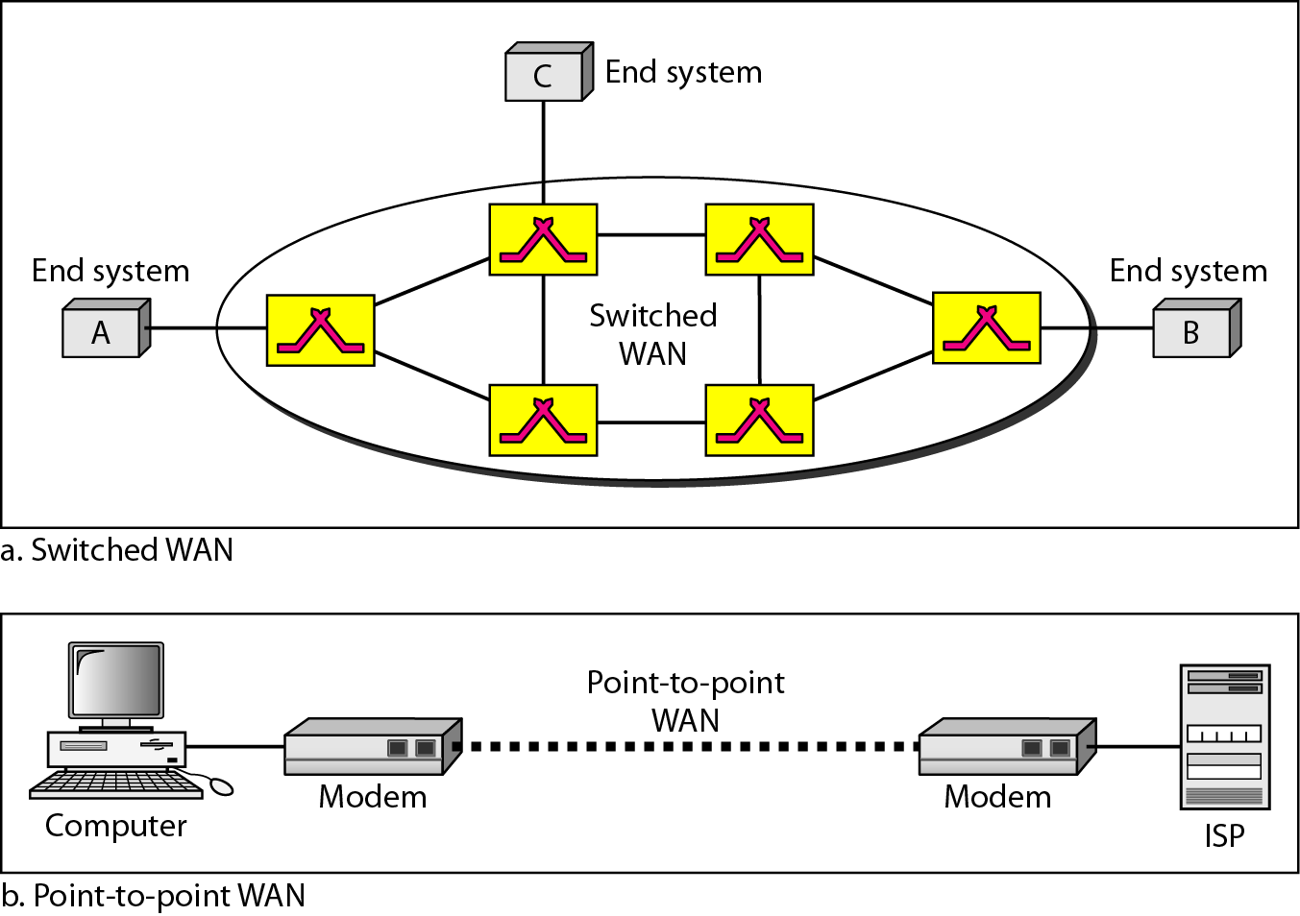
Computer Network Components
Figure 1.11 WANs: a switched WAN and a point-to-point WAN
Behrouz A. Forouzan,Sophia Chung Fegan,. 2007. Data communications and networking. McGraw Hill. New York. ISBN:007-125442-0

Slide 20
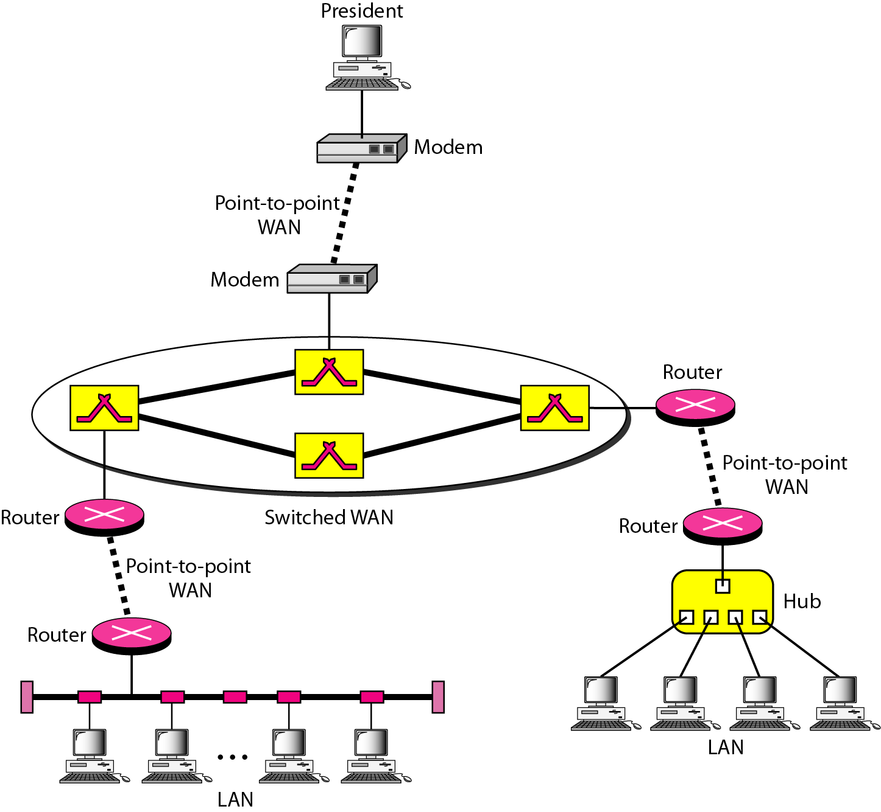
Computer Network Components
Figure 1.12 A heterogeneous network made of four WANs and two LANs
Behrouz A. Forouzan,Sophia Chung Fegan,. 2007. Data communications and networking. McGraw Hill. New York. ISBN:007-125442-0

